Slide 1

Analysis of bulk RNA-seq data
Analysis of Next-Generation Sequencing Data
Friederike Dündar
Applied Bioinformatics Core Slides at https://bit.ly/2T3sjRg¹
February 18, 2020
¹https://physiology.med.cornell.edu/faculty/skrabanek/lab/angsd/schedule_2020/
Analysis of bulk RNA-seq data

Slide 2




1
Why study RNA?
2
Different types of RNA – different library preps
3
Gene expression quantification
4 References
Analysis of bulk RNA-seq data

Slide 3
Why study RNA?
Why study RNA?
Analysis of bulk RNA-seq data

Slide 4
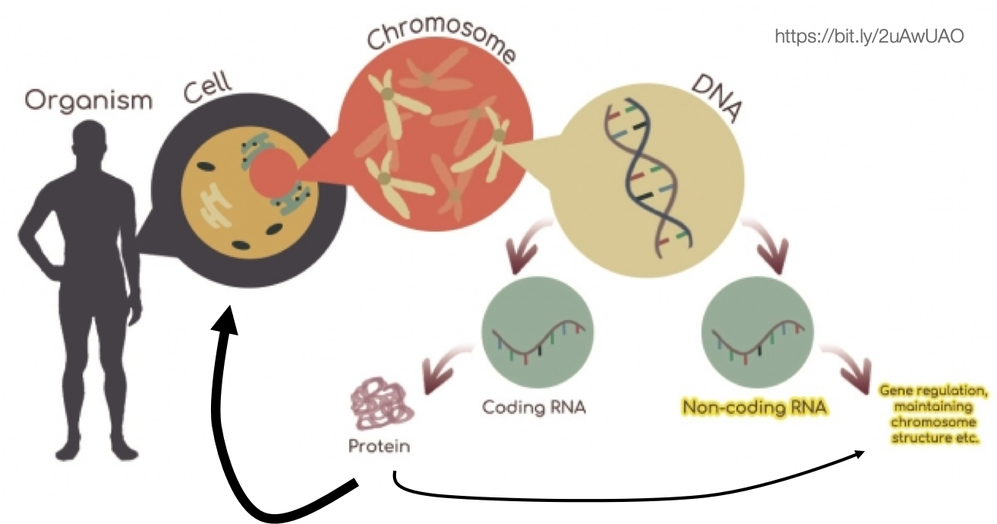
Why study RNA?
DNA is just the blueprint, it is not an effector molecule.
Analysis of bulk RNA-seq data

Slide 5
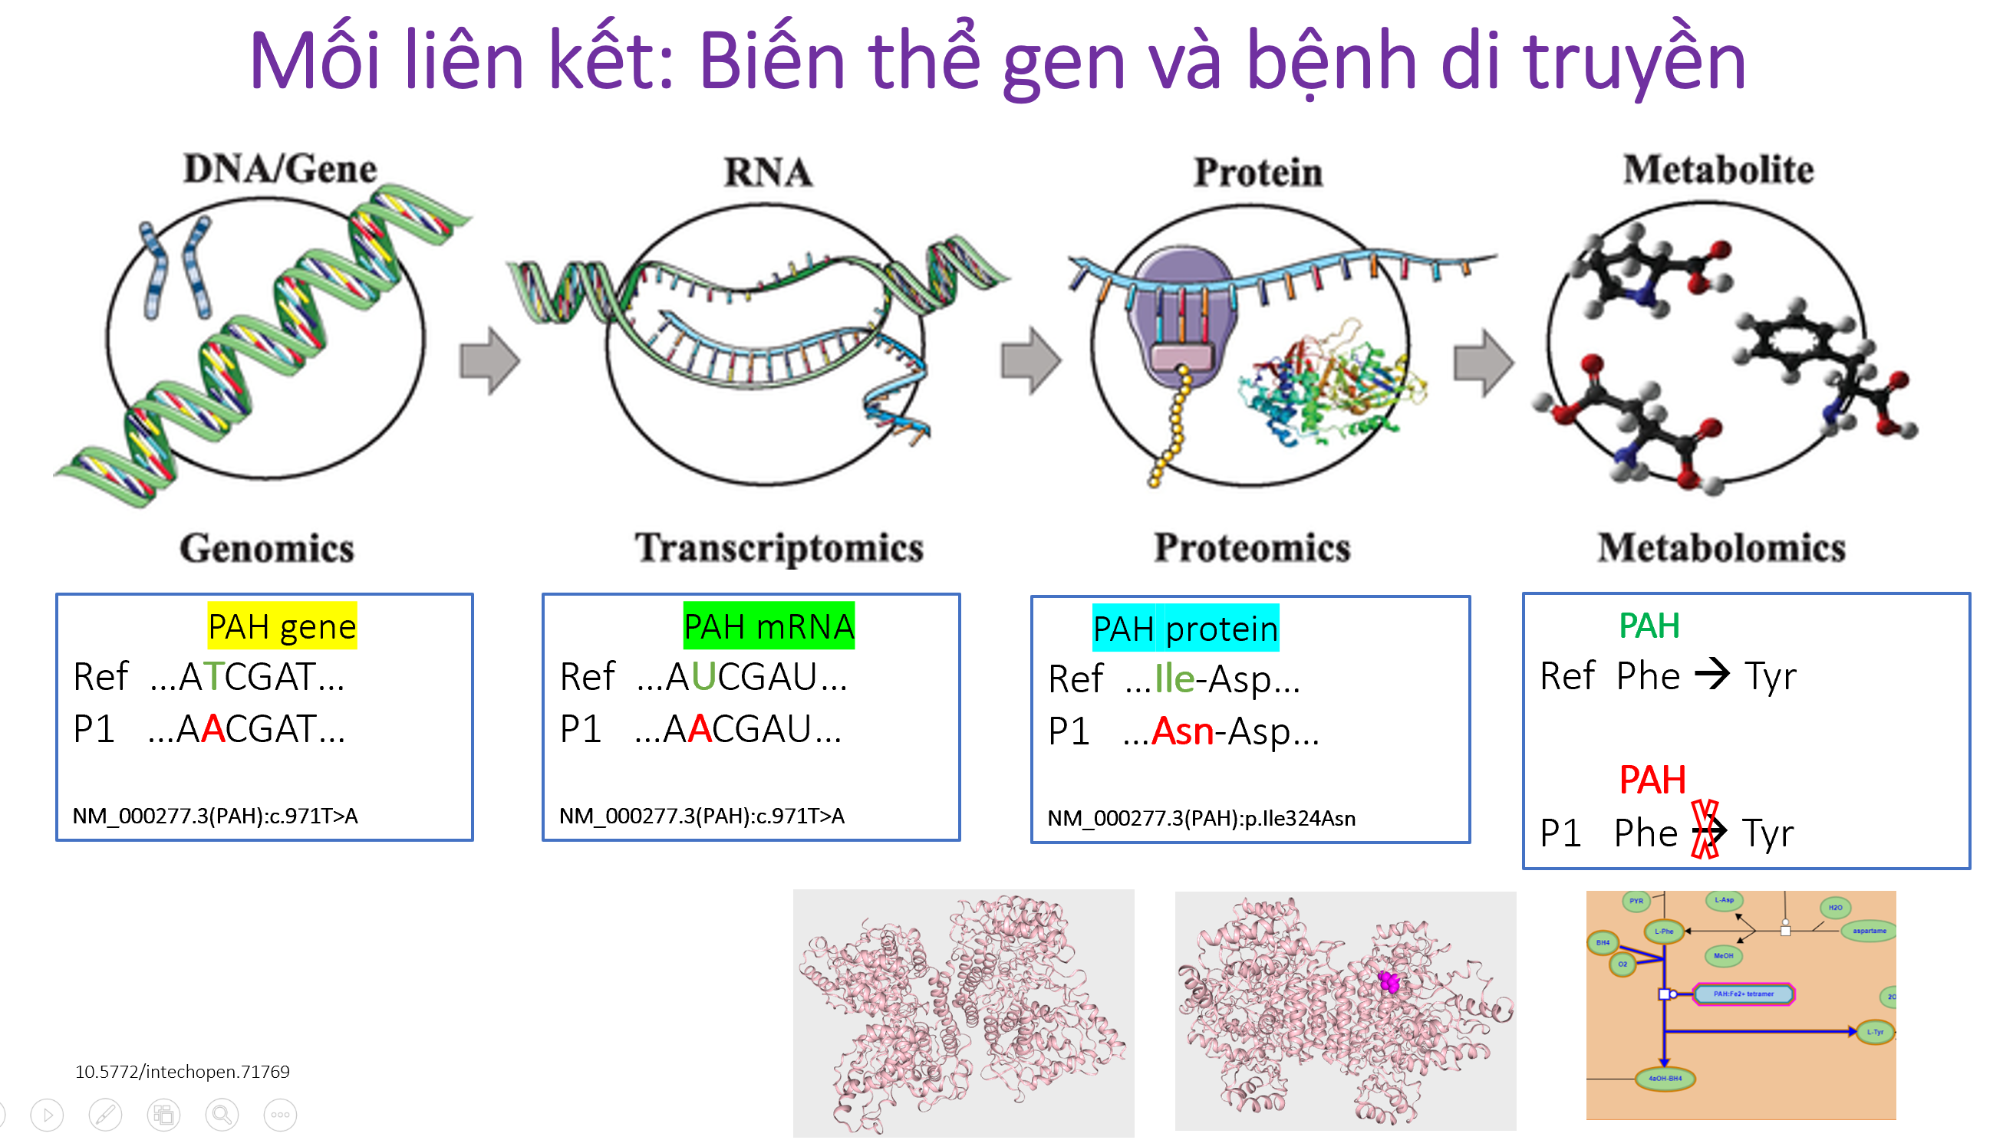

Slide 6
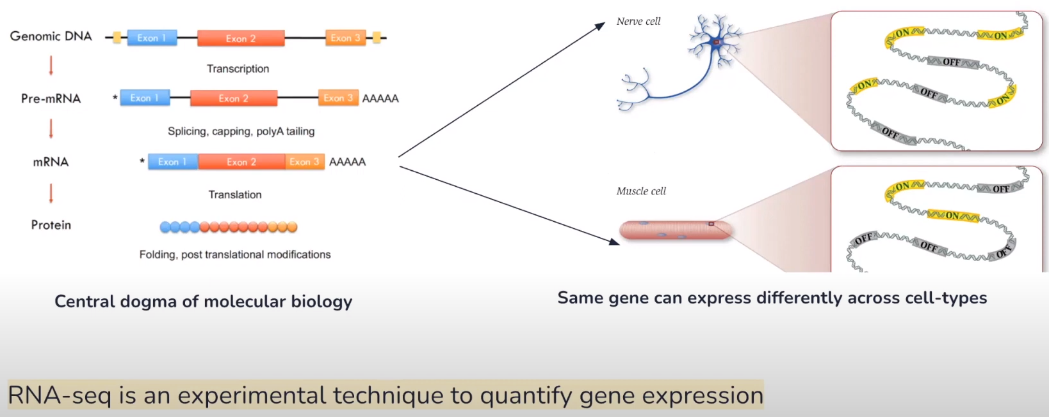
Analysis of bulk RNA-seq data

Slide 7
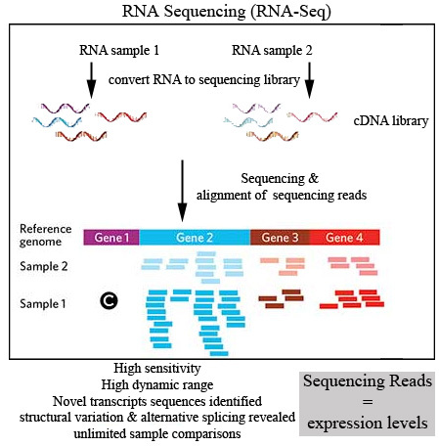

Slide 8
DNA is just the blueprint, it is not an effector molecule
Why study RNA?
GENOMICS
DNA sequence of an organism genetic basis of phenotypic differences
sites of DNA-protein or DNA-RNA interactions sites of open vs. closed chromatin
TRANSCRIPTOMICS
= characterization of gene products
identification of specific RNAs quantification of RNAs
RNA-protein interactions RNA structure
In order to understand the functional consequences (capacity) of a DNA sequence, we need to study its products, i.e. RNA and proteins.
Analysis of bulk RNA-seq data

Slide 9
Different types of RNA – different library preps
Different types of RNA – different library preps
Analysis of bulk RNA-seq data

Slide 10
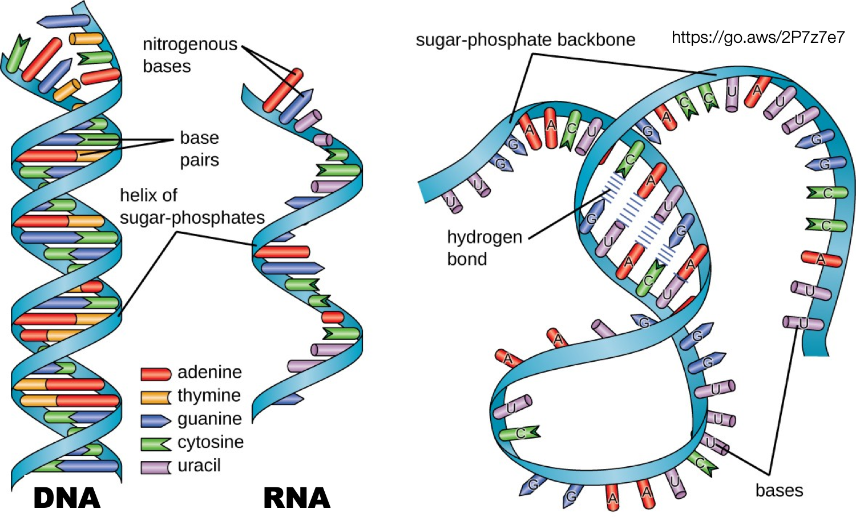
DNA and RNA have different properties
Different types of RNA – different library preps
DNA
usually double-stranded very stable
mutations are heritable
same amount in (almost) all cells same sequence in every cell of an organism
RNA
generally single-stranded, but with the capacity for complementary base pairing ⇒ ability to form myriad different shapes
usually fairly short-lived (minutes to hours)
easily degraded/damaged without protection
mutations are not passed on individual transcript amounts differ greatly depending on the gene, the cell type, the developmental status, the environment etc.
transcript sizes range from 10-20bp to several kb
Analysis of bulk RNA-seq data

Slide 11
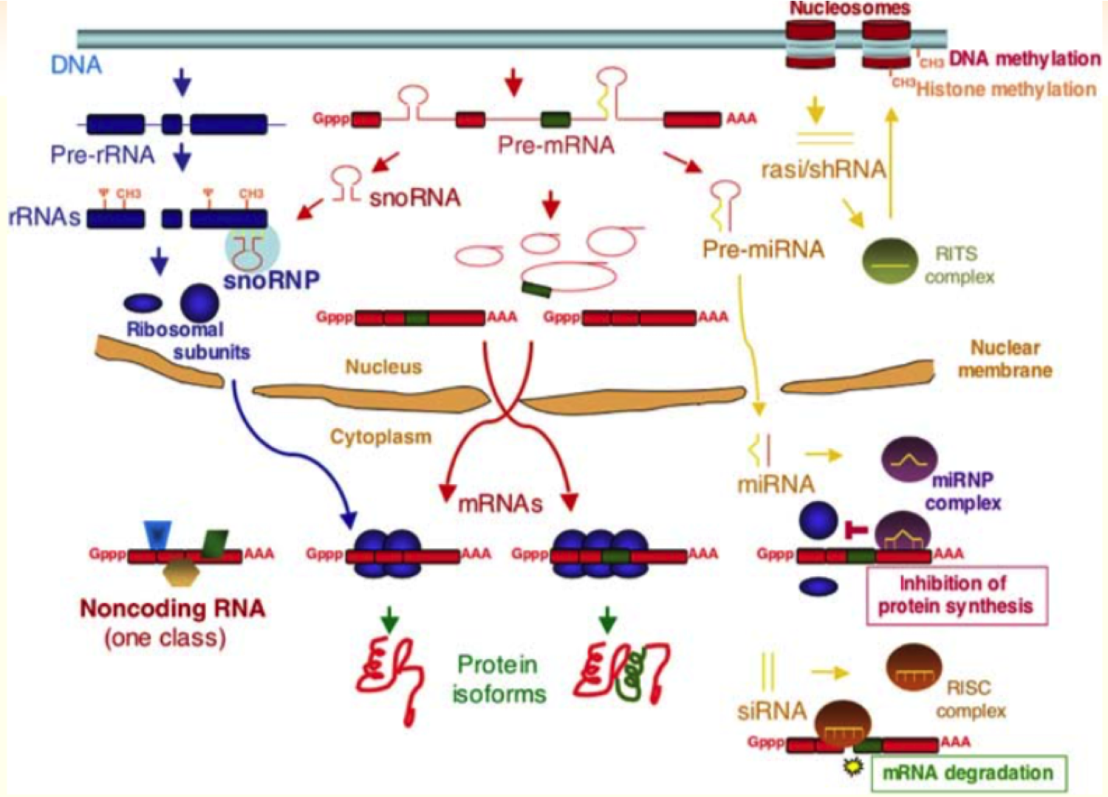
Different types of RNA
Different types of RNA – different library preps
There are numerous different types of functional RNA molecules in addition to messenger RNA, which does not carry out a function of its own except transporting the DNA code (genetic information) into the cytoplasm where it can be translated into proteins.
Analysis of bulk RNA-seq data

Slide 12
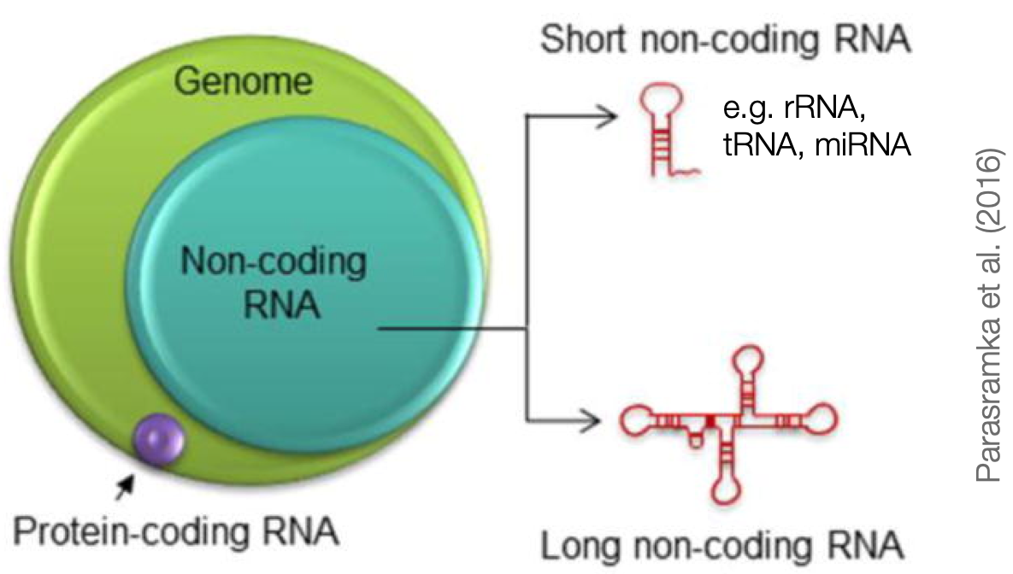
Different types of RNA
Different types of RNA – different library preps
ca. 75% of the human genome can be transcribed (= copied into RNA)
but <3% of the genome is subsequently translated into proteins genes can therefore be coding (⇒ final product: protein) or non-coding (⇒ final product: RNA)
non-coding RNAs cover a wide range of functions including protein assembly (⇒ ribosomal RNA, transfer RNA) and gene expression regulation
See Wilkes et al. [2017], Bartoszewski and Sikorski [2018] and Dai et al. [2020] for an introduction into the diverse RNA families and their func- tions.
Analysis of bulk RNA-seq data

Slide 13
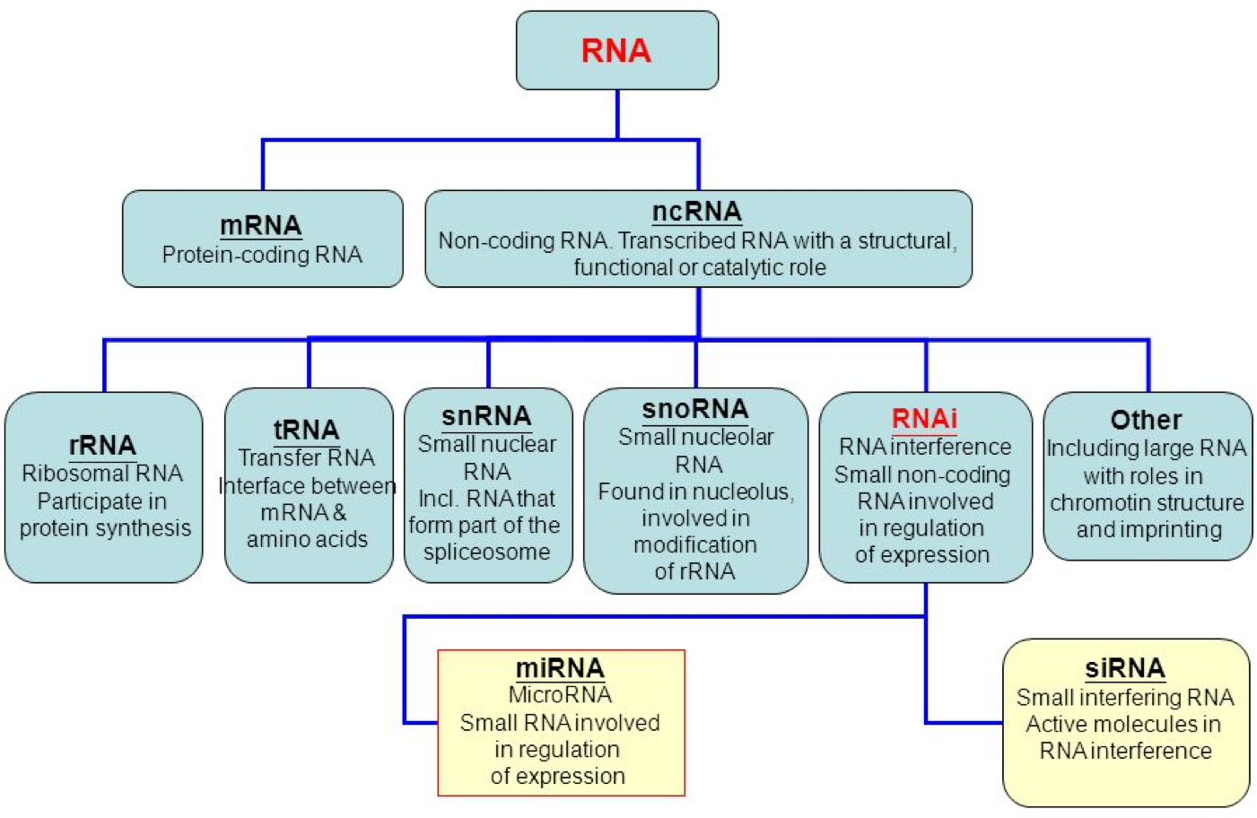
Different types of RNA – different library preps
Different types of RNA (there are more!)
Analysis of bulk RNA-seq data

Slide 14
Typical applications of RNA-seq
Different types of RNA – different library preps
identification of transcripts – which portions of the genome are expressed?
identification of splice variants
transcriptome assembly
detection of gene fusion events
quantification of transcripts
comparison of different cell types/conditions/diseases and their effect on individual mRNA quantities
allele-specific expression
Illumina technology is best suited for thequantification of known transcripts; its short reads are not a good match for the identification of novel transcripts in very complex transcriptomes such as the ones found in mammals.
Analysis of bulk RNA-seq data

Slide 15
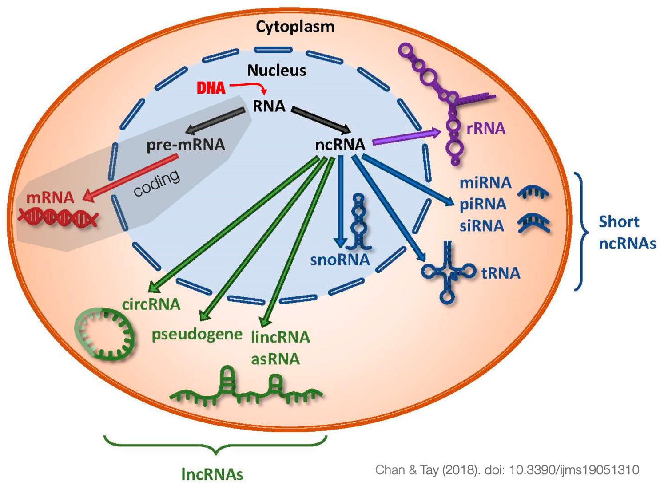
Sequencing prep protocol depends on the RNA properties
Different types of RNA – different library preps
It is not a one-size-fits-all situation!
abundance and stability
rRNA: 90-95% (!)
tRNA: 3-5%
mRNA: 2%
all other non-coding RNAs: well
below 1%
cellular location
most are in the cytoplasm
size
miRNAs: 18-23bp
mRNA: several 100 to 1000 bp
specific sequences/modifications
poly(A) tails of mRNA
2D structure
antisense transcripts
Analysis of bulk RNA-seq data

Slide 16
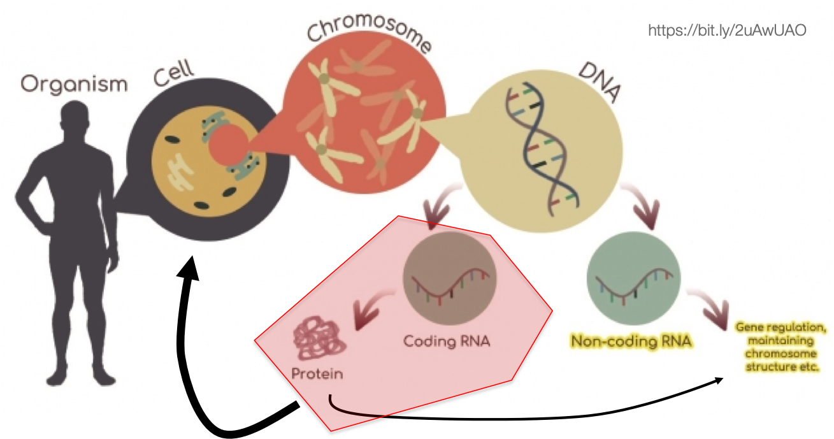
Focus today: messenger RNA
Different types of RNA – different library preps
mRNA amounts are used as a proxy for the amounts of their corresponding proteins within a given tissue.
Analysis of bulk RNA-seq data

Slide 17
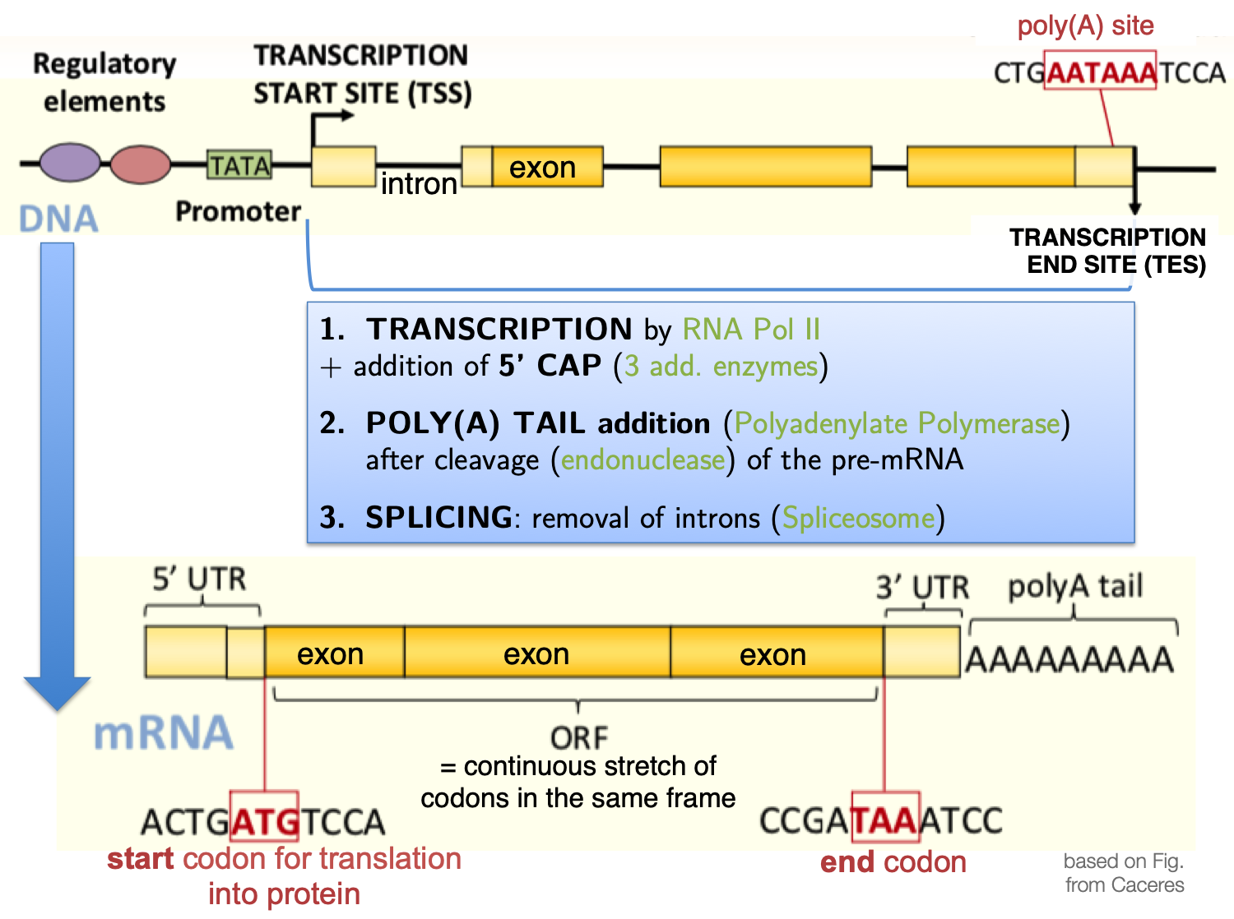
Different types of RNA – different library preps
Focus today: messenger RNA
Analysis of bulk RNA-seq data

Slide 18
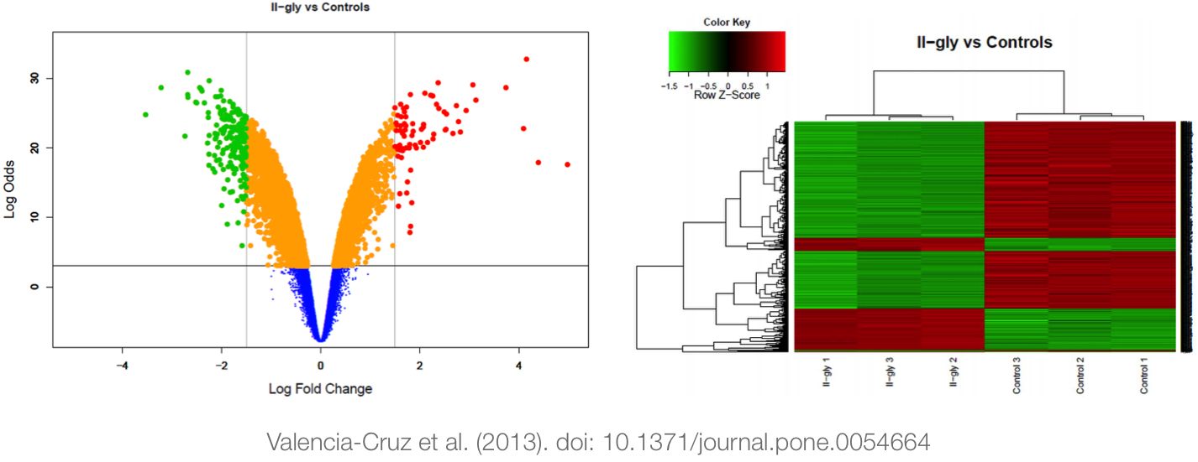
Focus today: messenger RNA
Different types of RNA – different library preps
Bulk RNA-seq of mRNA
expression quantification of (mostly) mRNA transcripts
extracted from populations of cells
and tested for gene-specific differences between distinct
conditions
Analysis of bulk RNA-seq data

Slide 19
Typical questions addressed with bulk RNA-seq
Different types of RNA – different library preps
Does a certain treatment induce gene expression changes? And if it does, which genes are most strongly affected?
How does the gene expression profile of a cancer cell differ from a healthy cell?
Which genes are turned on/off during the course of embryonic development?
Which genes differ in mice that have been engineered to lack a certain gene? E.g., which genes – in addition to the one that’s been “knocked-out” – may be depleted or overcompensating for the loss?
Which genes are activated in response to an environmental stimulus,
e.g. heat shock or alcohol poisoining?
How does the gene expression profile change in the same tissue in an aging individual?
. . .
Analysis of bulk RNA-seq data

Slide 20
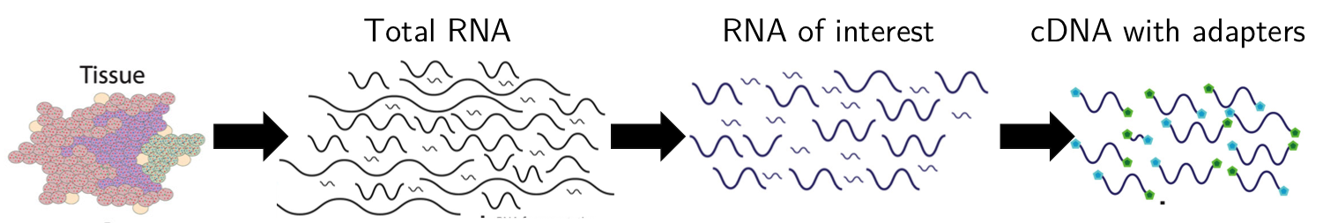
General steps of RNA-seq preparation
Different types of RNA – different library preps
RNA extraction² (cell lysis, RNA purification)
enrichment of the RNA of interest
fragmentation (ca. 200 bp)
cDNA synthesis
library prep to obtain cDNA with adapters for sequencing
1
2
3
4
5
²Most standard extraction methods will lose RNA <100 bp!
Analysis of bulk RNA-seq data

Slide 21
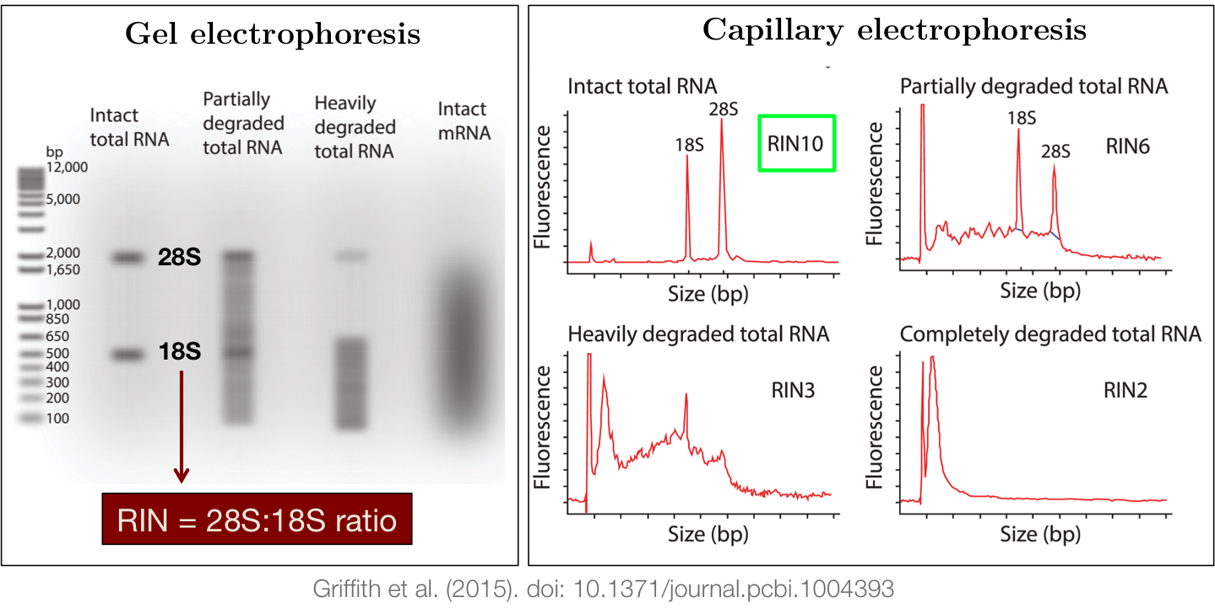
QC of RNA extraction
Different types of RNA – different library preps
Avoid degraded RNA! Optimum: RNA Integraty Score (RIN) of 10.
Analysis of bulk RNA-seq data

Slide 22
General steps of RNA-seq preparation
Different types of RNA – different library preps
RNA extraction (cell lysis, RNA purification)
enrichment of the RNA of interest
mRNA: poly(A) enrichment vs. ribosomal-depletion
small RNAs: size-based enrichment
fragmentation (ca. 200 bp)
cDNA synthesis
library prep to obtain cDNA with adapters for sequencing
1
2
3
4
5
Analysis of bulk RNA-seq data

Slide 23
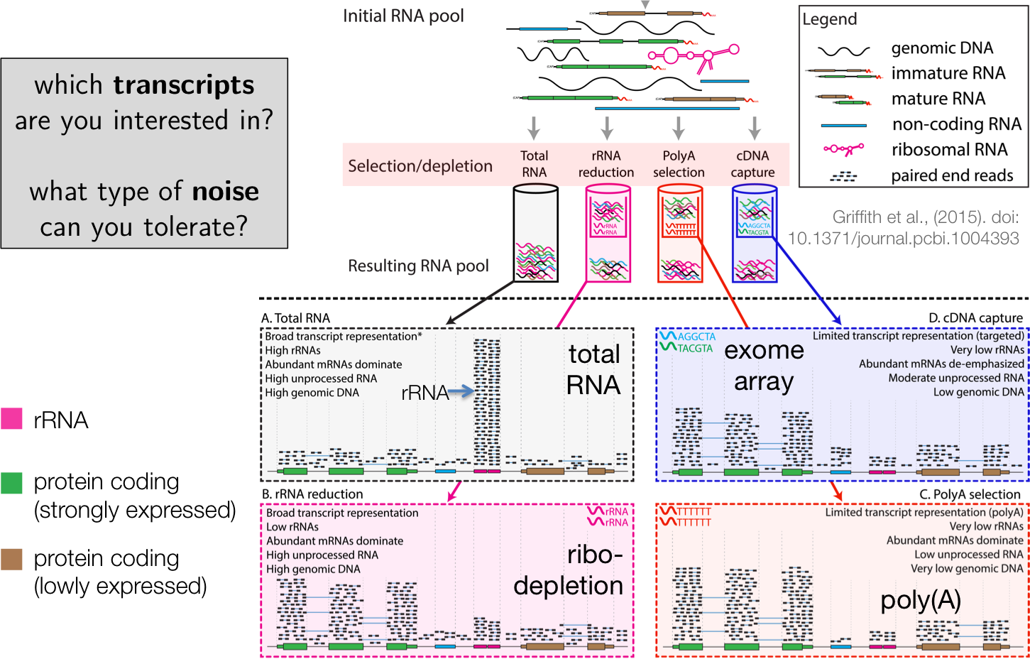
Every step has consequences – example: mRNA enrichment strategies
Different types of RNA – different library preps
Analysis of bulk RNA-seq data

Slide 24
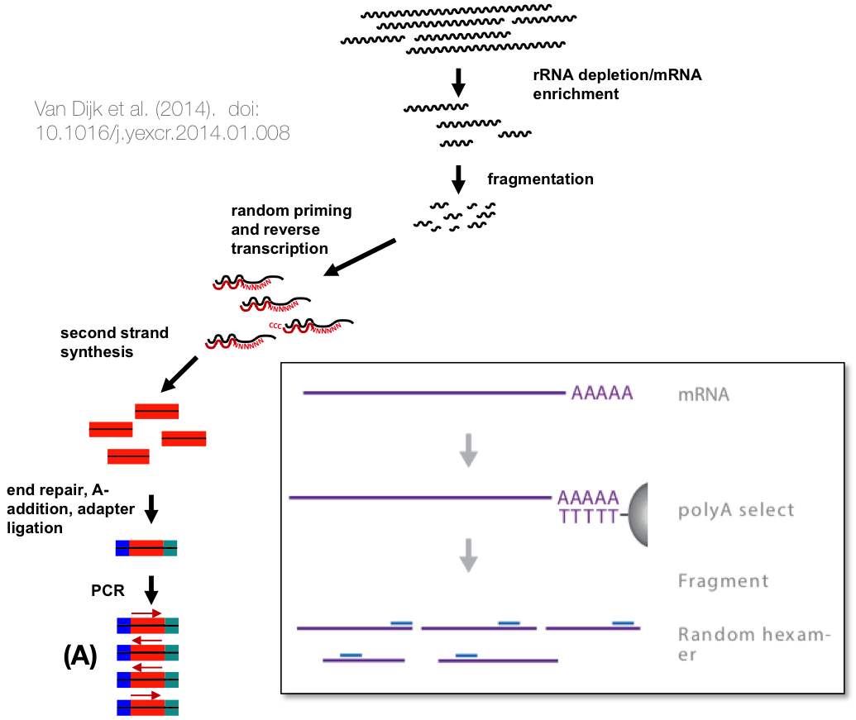
The most common library preparation methods
Different types of RNA – different library preps
(A) classical unstranded mRNA library prep
Analysis of bulk RNA-seq data

Slide 25
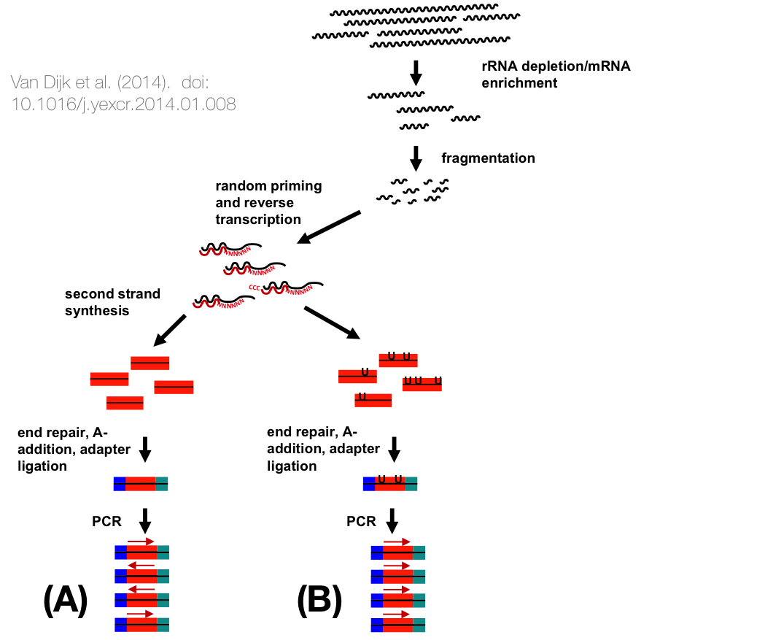
The most common library preparation methods
Different types of RNA – different library preps
classical unstranded mRNA library prep
stranded mRNA
(dUTP-based) (see Levin et al. [2010] and Zhao et al. [2015] for details)
Analysis of bulk RNA-seq data

Slide 26
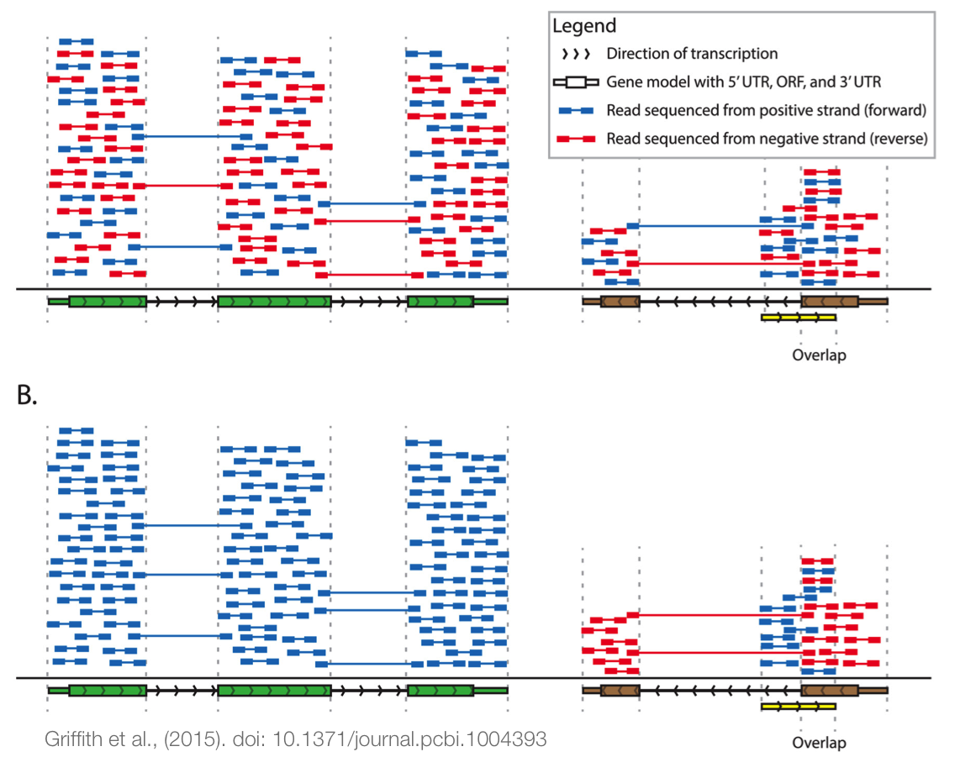
The most common library preparation methods
Different types of RNA – different library preps
Unstranded vs. stranded
Analysis of bulk RNA-seq data

Slide 27
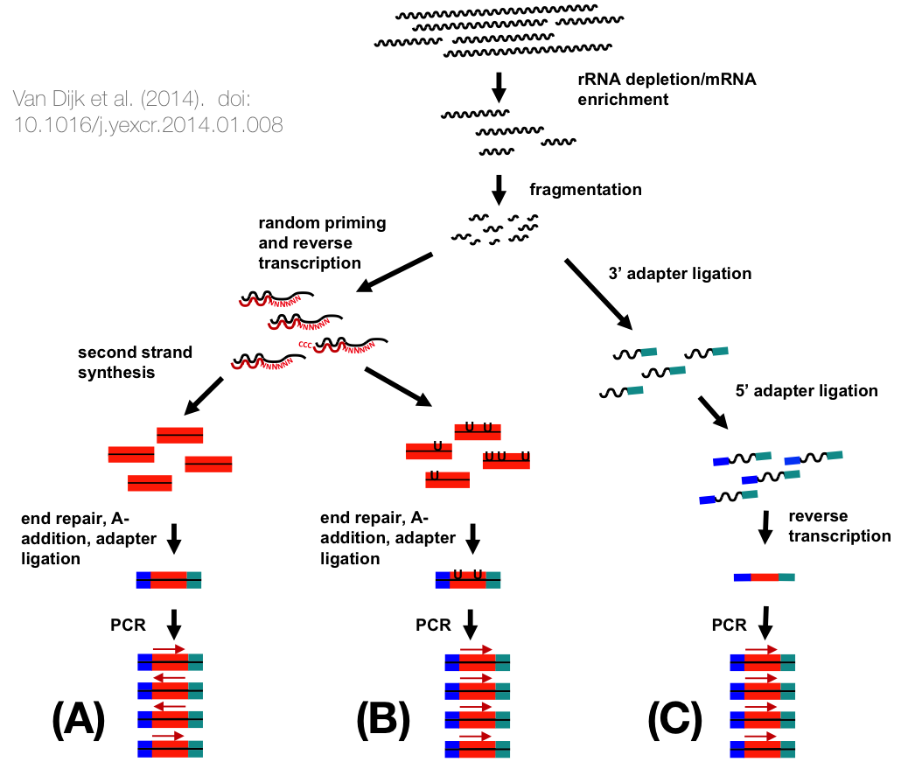
The most common library preparation methods
Different types of RNA – different library preps
classical unstranded mRNA library prep
stranded mRNA
(dUTP-based) (see Levin et al. [2010] and Zhao et al. [2015] for details)
small RNAs (miRNA, piRNA, tRNA, ... <100 bp)
using 2 adapters – not optimal for differential expression analyses!
Analysis of bulk RNA-seq data

Slide 28
Every step has consequences
Different types of RNA – different library preps
Do not mix different strategies for samples that are to be compared to each other!
extraction, enrichment, library prep
There are many papers comparing different aspects of different RNA-seq approaches, e.g.
Library preparation methods for next-generation sequencing: Tone down the bias [van Dijk et al., 2014]
Systematic comparison of small RNA library preparation protocols for next-generation sequencing [Dard-Dascot et al., 2018]
A comprehensive assessment of RNA-seq protocols for degraded and low-quantity samples. [Schuierer et al., 2017]
many more – PubMed is your friend!
Make an informed decision!
Analysis of bulk RNA-seq data

Slide 29
Gene expression quantification
Gene expression quantification
Analysis of bulk RNA-seq data

Slide 30
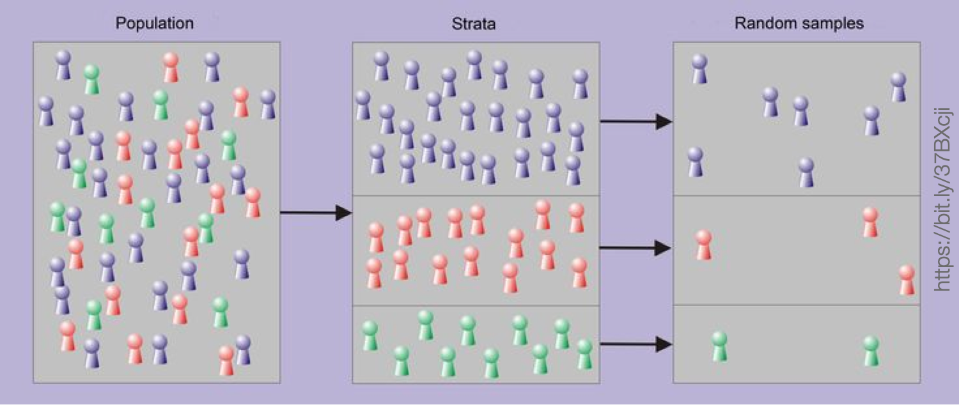
Sampling
Gene expression quantification
Basic assumption of RNA-seq-based transcript quantification:
The number of reads representing an individual transcript is reflecting its (relative!) abundance in the original transcript pool. This means that every tx is assumed to have the same chance of being captured (without degradation), sequenced and aligned.
Analysis of bulk RNA-seq data

Slide 31
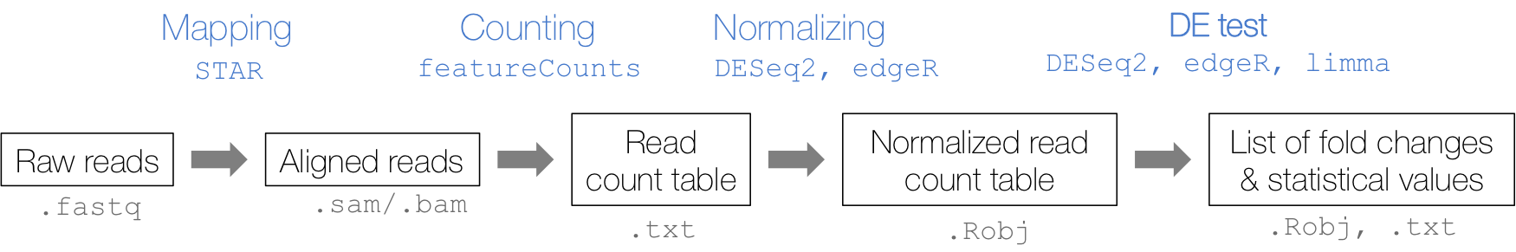
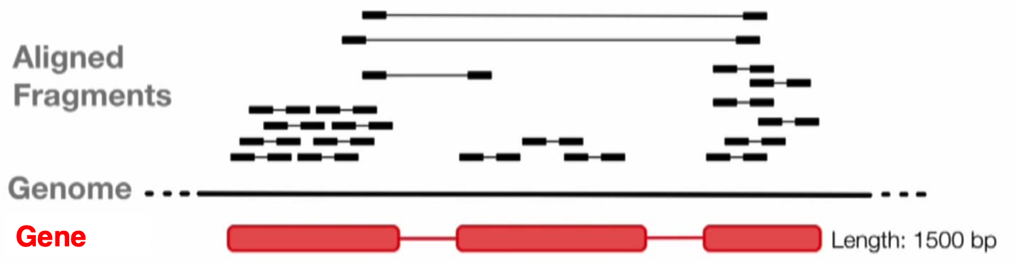
Quantification of gene expression following sequencing
Gene expression quantification
Typical bioinformatics workflow for bulk RNA-seq data
1
Read mapping
with splice-aware alignment tools! e.g. STAR [Dobin et al., 2013, Dobin and Gingeras, 2016, Ballouz et al., 2018]
using reference genome and reference transcriptome information
Count reads that overlap with annotated genes
2
Analysis of bulk RNA-seq data

Slide 32
Quantification of gene expression
Gene expression quantification
1. Aligning reads using STAR
$ cat align_Gierlinski.sh
#! /bin/bash
# Read in arguments STAR_DIR=$1 FASTQ_DIR=$2 SAMPLE=$3
# Define the list of fastq files per sample
FILES=''ls' ${FASTQ_DIR}/${SAMPLE}/*.fastq.gz | paste -s -d , -'
# Run STAR
STAR --genomeDir ${STAR_DIR}/ --readFilesIn $FILES \
--readFilesCommand gunzip -c --outFileNamePrefix ${SAMPLE}_ \
--outFilterMultimapNmax 1 \
--outSAMtype BAM SortedByCoordinate \
--runThreadN 4 --twopassMode Basic \
--alignIntronMin 1 --alignIntronMax 3000
You can see the entire script here: ~frd2007/ANGSD_2019/alignment/align_Gierlinski.sh.
Analysis of bulk RNA-seq data

Slide 33
Quantification of gene expression
Gene expression quantification
1. Aligning reads using STAR
# Make the script executable:
$ chmod 755 align_Gierlinski.sh
# Run it for all the samples of interest:
for SAMPLE in WT_1 WT_2 WT_3 WT_4 WT_5 SNF2_1 SNF2_2 SNF2_3 SNF2_4 SNF2_5
do
./align_Gierlinski.sh refGenome_S_cerevisiae/STARindex/ \ raw_reads_Gierlinski_yeast/ $SAMPLE
done
# Should have added the indexing of the BAM files to the script, # now I have to do it manually:
$ spack load samtools@1.9%gcc@6.3.0
$ for i in *bam
do
samtools index $i
done
Analysis of bulk RNA-seq data

Slide 34
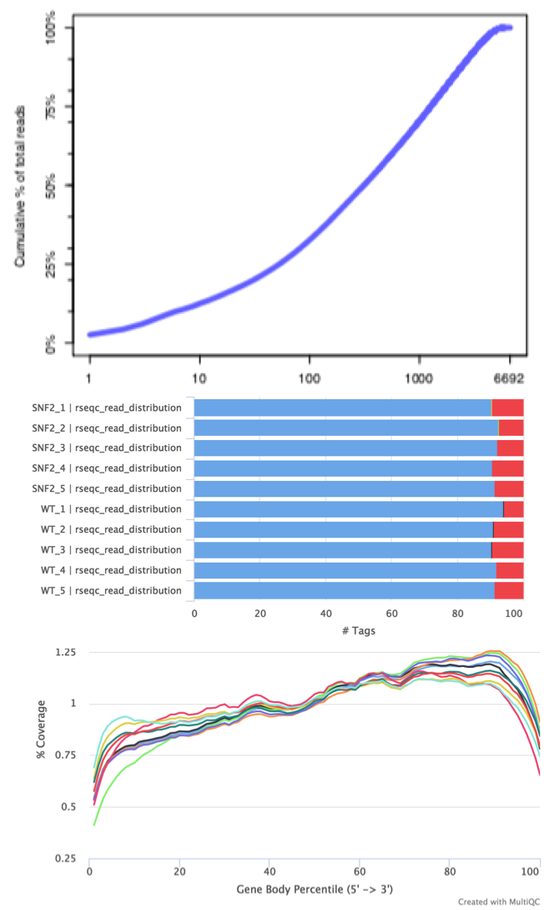
Typical biases of aligned reads of RNA-seq experiments
Gene expression quantification
lack of gene diversity: dominance of rRNAs, tRNAs (and/or other highly abundant transripts)
should be visible in FastQC
results already
read distribution
high intron coverage: incomplete poly(A) enrichment
many intergenic reads:
gDNA contamination
gene body coverage
3’ bias: RNA degradation (and indicator of poly(A) enrichment)
Analysis of bulk RNA-seq data

Slide 35
QC of aligned reads
Gene expression quantification
How many reads aligned?
⇒ aligner output (e.g., Log.final.out = STAR’s log file)
How well did the reads align?
⇒ samtools flagstat, RSeQC’s bam_stat
these provide summaries of the FLAG field values
Did we capture mostly exonic RNA?
⇒ RSeQC’s read_distribution.py, QoRTS
Do we see a pronounced 3’/5’ bias?
⇒ RSeQC’s geneBody_coverage.py, QoRTS
Analysis of bulk RNA-seq data

Slide 36
RSeQC package
Gene expression quantification
$ spack find | grep -i rseqc py-rseqc@2.6.4
# note the -r to load all dependencies for this python-based tool
$ spack load -r py-rseqc@2.6.4
publication: Wang et al. [2012] documentation: http://rseqc.sourceforge.net
see Table 11 of the RNA-seq workshop for a list of its scripts
the ones we use most often are are read_distribution and
geneBody_coverage.py
commands are not well standardized
e.g. sometimes the results are just printed to the screen, sometimes it generates a result file silently, sometimes you need to define a file name via -o
result files are not well standardized, either
from text output to R scripts to PDF documents
Analysis of bulk RNA-seq data

Slide 37
RSeQC: Read distribution
Gene expression quantification
How many reads fall into exons? Based on annotation file (BED!)
$ for SAMPLE in WT_1 WT_2 WT_3 WT_4 WT_5 SNF2_1 SNF2_2 SNF2_3 SNF2_4 SNF2_5
do
read_distribution.py -i bams/${SAMPLE}*.bam
-r ../RNA-seq/refGenome_S_cerevisiae/sacCer3.bed > \
${SAMPLE}/rseqc_read_distribution.out
done
$ head -n10 WT_1/rseqc_read_distribution.out
Total Reads | 1049466
Total Tags | 1059871
Total Assigned Tags 992608 =====================================================================
Group | Total_bases | Tag_count | Tags/Kb
CDS_Exons | 8832031 | 990363 | 112.13
5'UTR_Exons | 0 | 0 | 0.00
3'UTR_Exons | 0 | 0 | 0.00
Introns | 69259 | 630 | 9.10
TSS_up_1kb | 2421198 | 1260 | 0.52
Analysis of bulk RNA-seq data

Slide 38
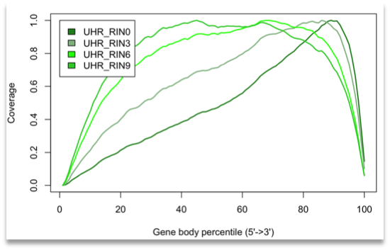
RSeQC: Gene body coverage
Gene expression quantification
$ for SAMPLE in WT_1 WT_2 WT_3 WT_4 WT_5 SNF2_1 SNF2_2 SNF2_3 SNF2_4 SNF2_5
do
geneBody_coverage.py -i bams/${SAMPLE}*.bam \
-r ../RNA-seq/refGenome_S_cerevisiae/sacCer3.bed \
-o ${SAMPLE}/rseqc_geneBody_coverage.out &
done
Analysis of bulk RNA-seq data

Slide 39
QoRTs – an alternative to RSeQC
Gene expression quantification
$ spack find | grep -i qorts
$ spack load qorts@1.2.42
$ QORTS_LOC='spack location -i qorts' # need location of the java executable
# run QoRTs in summary mode
$ for SAMPLE in WT_1 WT_2 WT_3 WT_4 WT_5 SNF2_1 SNF2_2 SNF2_3 SNF2_4 SNF2_5
do
java -Xmx4G -jar ${QORTS_LOC}/bin/QoRTs.jar QC --singleEnded
--generatePdfReport \ bams/${SAMPLE}*.bam \
../RNA-seq/refGenome_S_cerevisiae/sacCer3.gtf $SAMPLE
done
more convenient and standardized usage than RSeQC
offers gene diversity plot and more fine-grained plots where genes are stratified by expression strength [Hartley and Mullikin, 2015]
will bundle numerous analyses in one PDF and allows for direct cross-comparisons, but MultiQC doesn’t handle it very robustly
Analysis of bulk RNA-seq data

Slide 40
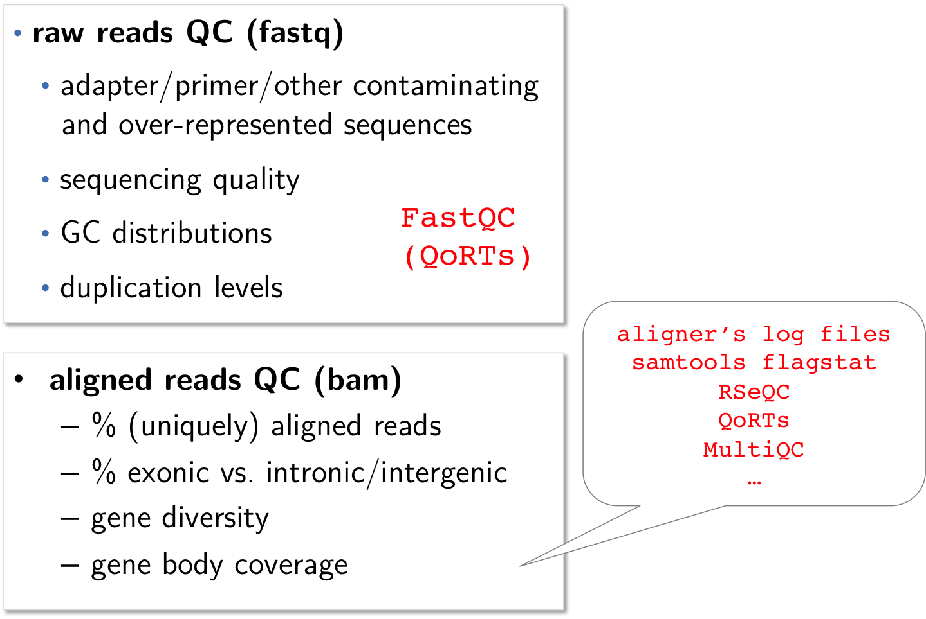
Gene expression quantification
Summary of RNA-seq alignment QC
Analysis of bulk RNA-seq data

Slide 41
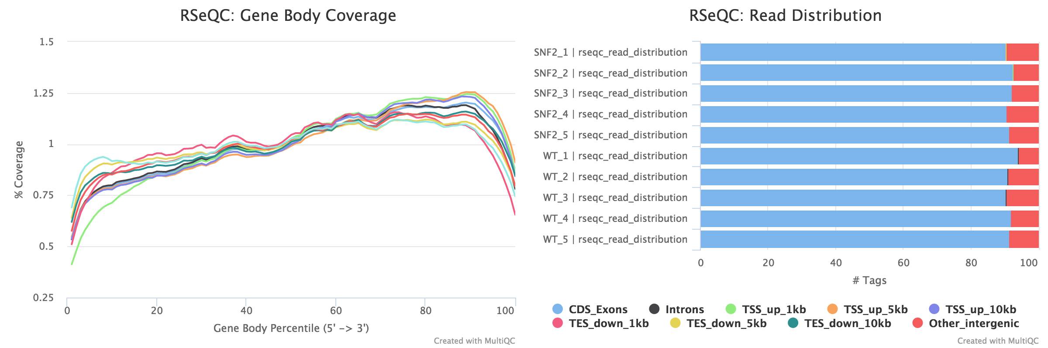
Summary of RNA-seq alignment QC
Gene expression quantification
1
Did you capture a diverse set of mRNAs? (or RNAs of the type that you expect)?
Are the gene bodies covered similarly across different samples? Is there evidence for contaminations, either from highly abundant, irrelevant transcripts or from genomic DNA?
2
3
Analysis of bulk RNA-seq data

Slide 42
Quantification of gene expression following sequencing
Gene expression quantification
Typical bioinformatics workflow for bulk RNA-seq data
1
Read mapping
with splice-aware alignment tools! e.g. STAR
using reference genome and reference transcriptome information
Count reads that overlap with annotated genes
the more often a transcript was present in a cell population, the more reads we should have mapped there
2
Analysis of bulk RNA-seq data

Slide 43
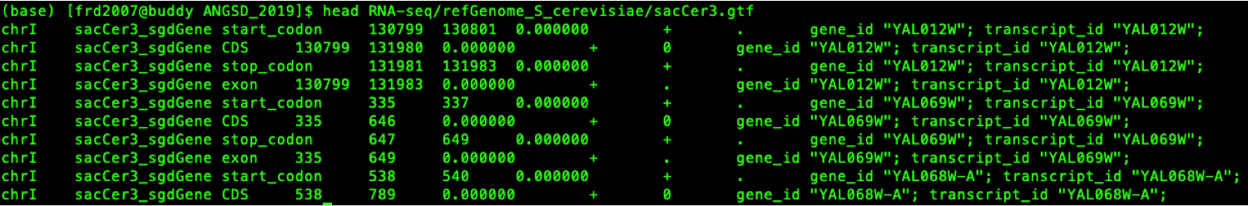
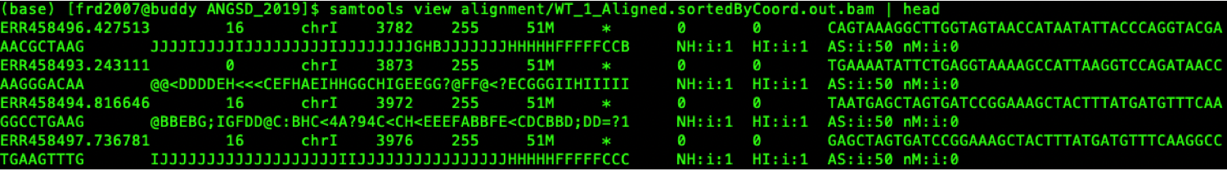
Quantification of gene expression following sequencing
Gene expression quantification
2. Counting read-gene overlaps with featureCounts post-alignment Several tools are available for this task; featureCounts is the fastest one [Liao et al., 2014].
Minimal input for counting read-gene overlaps:
GTF file defining the loci from which RNA could have originated
BAM file with the genome coordinates of each sequenced read
Analysis of bulk RNA-seq data

Slide 44
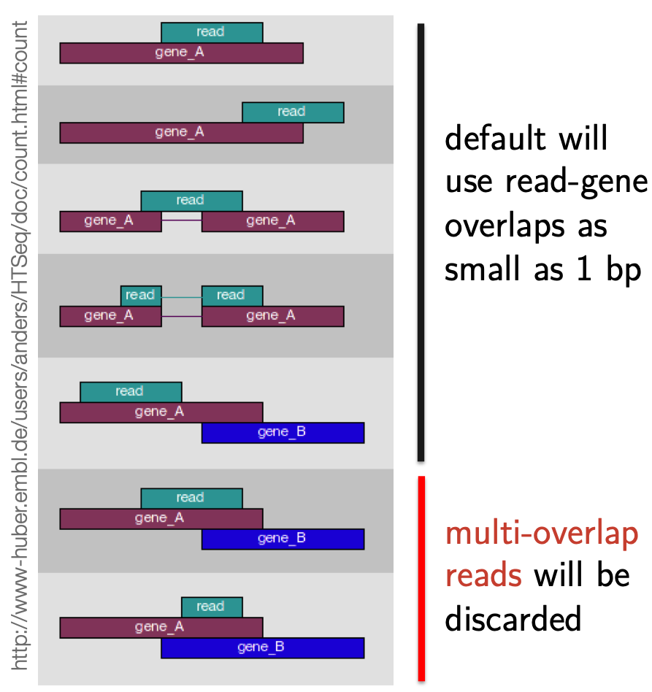
Quantification of gene expression following sequencing
Gene expression quantification
2. Counting read-gene overlaps with featureCounts post-alignment
features = single rows within the GTF file, e.g. exons
meta-features = how single rows may be grouped together,
e.g. by transcript-id or
gene-id (-g option)
See http://bioinf.wehi.edu.au/featureCounts/ and Chapter 7 of SubreadUsersGuide.pdf for details of featureCounts usage!
Analysis of bulk RNA-seq data

Slide 45
Quantification of gene expression following sequencing
Gene expression quantification
2. Counting read-gene overlaps with featureCounts post-alignment
# featureCounts is part of the subread suite
$ spack load subread
# we can use all BAM files in the folder alignment via *.bam
$ featureCounts -a sacCer3.gtf \
-o featCounts_Gierlinski_genes.txt \
../alignment/*.bam
The default featureCounts settings include summarization at the meta-feature level identified via “gene id” in the GTF file.
Analysis of bulk RNA-seq data

Slide 46
Quantification of gene expression following sequencing
Gene expression quantification
2. Counting read-gene overlaps with featureCounts post-alignment
2 result files:
(1) .txt.summary: how many reads could be assigned to a feature
Status | SNF2_1 | SNF2_2 | SNF2_3 | SNF2_4 | SNF2_5
Assigned | 9518261 | 8025575 | 8099295 | 9933479 | 6389328
Unassigned_Unmapped | 0 | 0 | 0 | 0 | 0
Unassigned_MappingQuality | 0 | 0 | 0 | 0 | 0
Unassigned_Chimera | 0 | 0 | 0 | 0 | 0
Unassigned_FragmentLength | 0 | 0 | 0 | 0 | 0
Unassigned_Duplicate | 0 | 0 | 0 | 0 | 0
Unassigned_MultiMapping | 0 | 0 | 0 | 0 | 0
Unassigned_Secondary | 0 | 0 | 0 | 0 | 0
Unassigned_Nonjunction | 0 | 0 | 0 | 0 | 0
Unassigned_NoFeatures | 747388 | 458993 | 493370 | 750124 | 433271
Unassigned_Overlapping_Length | 0 | 0 | 0 | 0 | 0
Unassigned_Ambiguity | 586529 | 527766 | 544541 | 612430 | 427882
This file can easily be included in any MultiQC report.
Analysis of bulk RNA-seq data

Slide 47
Quantification of gene expression following sequencing
Gene expression quantification
2. Counting read-gene overlaps with featureCounts post-alignment
(2) .txt: contains the actual read counts per feature
$ head -1 featCounts_Gierlinski_genes.txt.
# Program:featureCounts v1.6.2; Command:"featureCounts" "-a" "sacCer3.gtf" "-o" # "featCounts_Gierlinski_genes.txt" "SNF2_1" "SNF2_2" "SNF2_3" "SNF2_4" "SNF2_5" # "WT_1" "WT_2" "WT_3"
Geneid | Chr | Start | End | Strand | Length | SNF2_1 | SNF2_2 | SNF2_3
YAL012W | chrI | 130799 | 131983 | + | 1185 | 7351 | 7180 | 7648
YAL069W | chrI | 335 | 649 | + | 315 | 0 | 0 | 0
YAL068W-A | chrI | 538 | 792 | + | 255 | 0 | 0 | 0
YAL068C | chrI | 1807 | 2169 | - | 363 | 2 | 2 | 2
YAL067W-A | chrI | 2480 | 2707 | + | 228 | 0 | 0 | 0
YAL067C | chrI | 7235 | 9016 | - | 1782 | 103 | 51 | 44
This is the file you’re going to use for downstream processing and analyses.
Analysis of bulk RNA-seq data

Slide 48
References
References
Analysis of bulk RNA-seq data

Slide 49
Figures taken from the following publications:
References
[Cáceres, 2012, Chan and Tay, 2018, Dündar et al., 2019, Griffith et al., 2015, Parasramka et al., 2016, Valencia-Cruz et al., 2013, van Dijk et al., 2014]
Analysis of bulk RNA-seq data

Slide 50
Sara Ballouz, Alexander Dobin, Thomas R Gingeras, and Jesse Gillis. The fractured landscape of RNA-seq alignment: the default in our STARs. Nucleic Acids Research, 46(10):5125–5138, 05 2018. doi: 10.1093/nar/gky325. URL https://dx.doi.org/10.1093/nar/gky325.
Rafal Bartoszewski and Aleksander F. Sikorski. Editorial focus: entering into the non-coding RNA era. Cellular and Molecular Biology Letters, 2018. doi: 10.1186/s11658-018-0111-3.
References
Mario Cáceres. Functional genomics and transcriptomics, 2012. URL http://bioinformatica.uab.cat/base/documents/mastergp/ Transcriptomics_2012.pdf.
Jia Jia Chan and Yvonne Tay. Noncoding RNA: RNA regulatory networks in cancer. International Journal of Molecular Sciences, 2018. doi: 10.3390/ijms19051310.
Xiaofeng Dai, Shuo Zhang, and Kathia Zaleta-Rivera. RNA: interactions drive functionalities. Molecular Biology Reports, 47(2):1413–1434, 2020. doi: 10.1007/s11033-019-05230-7.
Analysis of bulk RNA-seq data

Slide 51
Cloelia Dard-Dascot, Delphine Naquin, Yves D’Aubenton-Carafa, Karine Alix, Claude Thermes, and Erwin van Dijk. Systematic comparison of small RNA library preparation protocols for next-generation sequencing. BMC Genomics, 2018. doi: 10.1186/s12864-018-4491-6.
Alexander Dobin and Thomas R. Gingeras. Optimizing RNA-seq mapping with STAR. In Methods in Molecular Biology, volume 1415, pages 245–262. Humana Press, New York, NY, 2016. doi:
References
10.1007/978-1-4939-3572-7_13.
Alexander Dobin, Carrie A. Davis, Felix Schlesinger, Jorg Drenkow, Chris Zaleski, Sonali Jha, Philippe Batut, Mark Chaisson, and Thomas R. Gingeras. STAR: Ultrafast universal RNA-seq aligner. Bioinformatics, 29 (1):15–21, 2013. doi: 10.1093/bioinformatics/bts635.
Friederike Dündar, Luce Skrabanek, and Paul Zumbo. Introduction to differential gene expression analysis using rna-seq, 2019. URL http://chagall.med.cornell.edu/RNASEQcourse/Intro2RNAseq.pdf.
Analysis of bulk RNA-seq data

Slide 52
Malachi Griffith, Jason R. Walker, Nicholas C. Spies, Benjamin J. Ainscough, and Obi L. Griffith. Informatics for RNA Sequencing: A Web Resource for Analysis on the Cloud. PLoS Computational Biology, 11(8), 2015. doi: 10.1371/journal.pcbi.1004393.
Stephen W Hartley and James C Mullikin. QoRTs: a comprehensive toolset for quality control and data processing of RNA-Seq experiments. BMC Bioinformatics, 16(1):224, January 2015. ISSN 1471-2105. doi: 10.1186/s12859-015-0670-5.
References
Joshua Z Levin, Moran Yassour, Xian Adiconis, Chad Nusbaum, Dawn Anne Thompson, Nir Friedman, Andreas Gnirke, and Aviv Regev.
Comprehensive comparative analysis of strand-specific RNA sequencing methods. Nature Methods, 7(9):709–715, 2010. doi: 10.1038/nmeth.1491.
Yang Liao, Gordon K Smyth, and Wei Shi. featureCounts: an efficient general purpose program for assigning sequence reads to genomic features. Bioinformatics, 30(7):923–30, April 2014. ISSN 1367-4811. doi: 10.1093/bioinformatics/btt656.
Analysis of bulk RNA-seq data

Slide 53
Mansi A. Parasramka, Sayantan Maji, Akiko Matsuda, Irene K. Yan, and Tushar Patel. Long non-coding RNAs as novel targets for therapy in hepatocellular carcinoma. Pharmacology and Therapeutics, pages 67–78, 2016. doi: 10.1016/j.pharmthera.2016.03.004.
Sven Schuierer, Walter Carbone, Judith Knehr, Virginie Petitjean, Anita Fernandez, Marc Sultan, and Guglielmo Roma. A comprehensive assessment of RNA-seq protocols for degraded and low-quantity samples. BMC Genomics, 2017. doi: 10.1186/s12864-017-3827-y.
References
Alejandra Idan Valencia-Cruz, Laura I. Uribe-Figueroa, Rodrigo Galindo-Murillo, Karol Baca-López, Anllely G. Gutiérrez, Adriana Vázquez-Aguirre, Lena Ruiz-Azuara, Enrique Hernández-Lemus, and Carmen Mejía. Whole Genome Gene Expression Analysis Reveals Casiopeína-Induced Apoptosis Pathways. PLoS ONE, 2013. ISSN 19326203. doi: 10.1371/journal.pone.0054664.
Analysis of bulk RNA-seq data

Slide 54
Erwin L van Dijk, Yan Jaszczyszyn, and Claude Thermes. Library preparation methods for next-generation sequencing: tone down the bias. Experimental cell research, 322(1):12–20, Mar 2014. doi: 10.1016/j.yexcr.2014.01.008.
Liguo Wang, Shengqin Wang, and Wei Li. RSeQC: Quality control of RNA-seq experiments. Bioinformatics, 28(16):2184–2185, 2012. doi: 10.1093/bioinformatics/bts356.
References
M.C. Wilkes, C.E. Repellin, and K.M. Sakamoto. Beyond mRNA: The role of non-coding RNAs in normal and aberrant hematopoiesis. Molecular Genetics and Metabolism, 2017. doi: 10.1016/j.ymgme.2017.07.008.
Shanrong Zhao, Ying Zhang, William Gordon, Jie Quan, Hualin Xi, Sarah Du, David von Schack, and Baohong Zhang. Comparison of stranded and non-stranded RNA-seq transcriptome profiling and investigation of gene
overlap. BMC Genomics, 2015. doi: 10.1186/s12864-015-1876-7.
Analysis of bulk RNA-seq data

